Slide 1

BBER February 6.2024
James Williamson, Sage Appraisal & Strategy
Discover Kalispell Chamber Board of Director
Notes:
Good morning! I know we are limited on our time and Pat is a task master so we are going to dive right in. My name is Jame Williamson of Sage Appraisal & Strategy. It’s been my privilege to serve on the Discover Kalispell Chamber board of directors for the past two years. Lorraine Clarno, our President & CEO is down in California this week handing over the reigns of the Western Association of Chamber Executives completing her term as chair of that board. She said to say a big hello to you all!

Slide 2

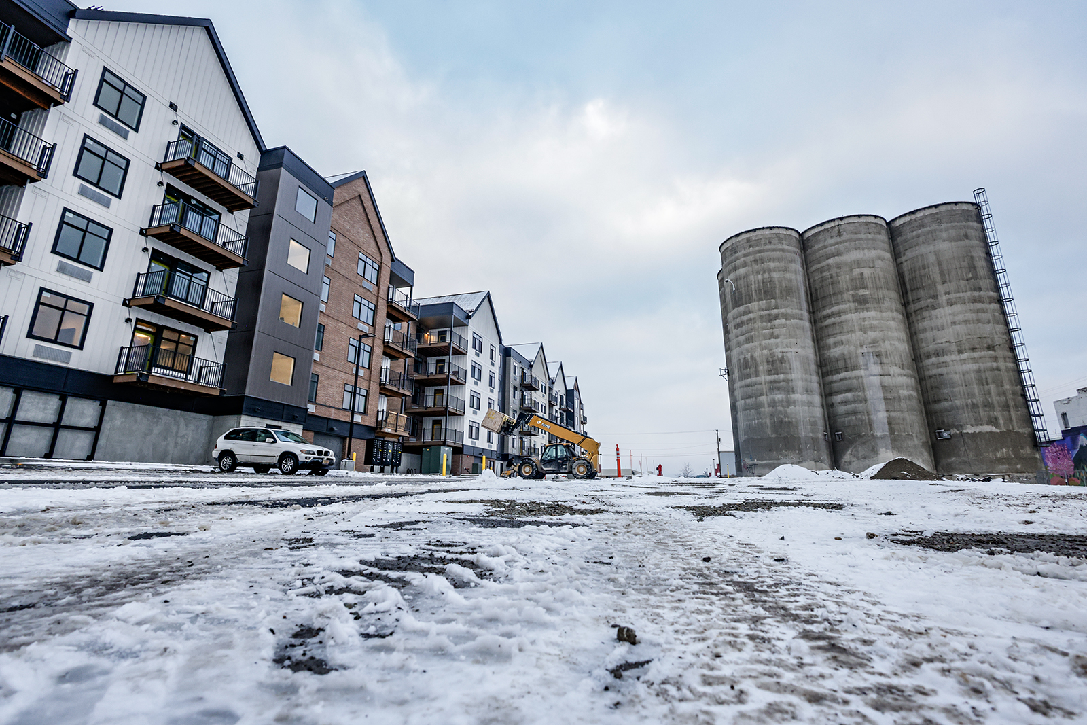
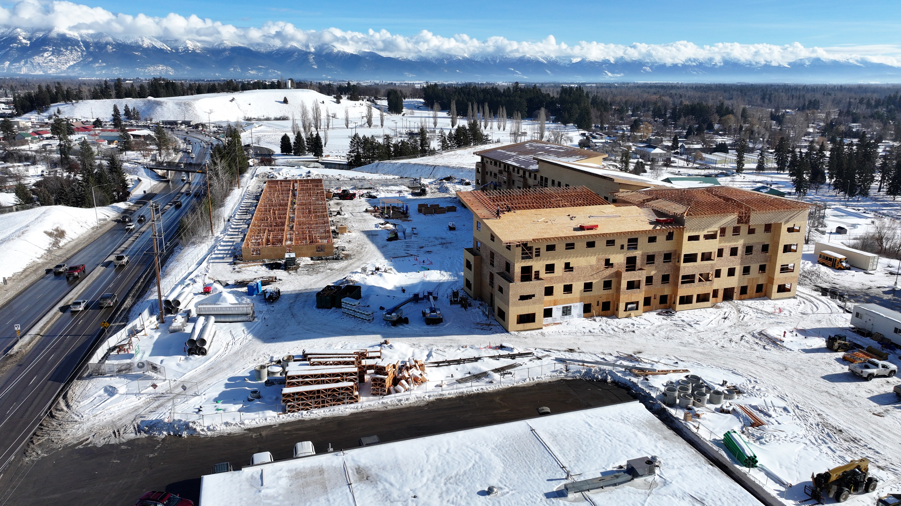
Kalispell is Growing Up
Slower…but steady as she goes
ParkLine Towers
Silos - 40 Units opened February 1st
Notes:
While permitting has slowed in 2023, both residential and commercial, projects continue toward completion. Parkline Towers anticipated completion date is summer 2025.
Developments in the core and on the Parkline are making progress and we are seeing continued growth on the western side of the Kalispell.
Flathead County will soon be home to a much needed septage facility which is south of Kalispell.

Slide 3

Stats -
2022
2023
Kalispell Population – 28,450
Flathead County – 108,386
Poverty Rate – 17.80%
Median Sales Home Price - $569,000 (Redfin)
Kalispell Population – 31,212
Flathead Population – 117,992
Poverty Rate – 9.2% (County)
Median Sales Home Price-County $567,500 (Redfin – down 15%) Peak: April 2022 $692,400
Flathead County has grown 20.68% since 2010.
Montana ranks 13th in the nation for largest percentage of in-migration from 2020 to 2022 with 39,041.
Housing supply grew by 6.2% from 2010 – 2020, while the population grew by 14.8%
Source: US Census Bureau and worldpopulationreview.com
Notes:
According to World Population Review:
Kalispell has a 2024 population of 31,212. Kalispell is currently growing at a rate of 6.13% annually and its population has increased by 26.87% since the most recent census, which recorded a population of 24,602 in 2020.
The average household income in Kalispell is $70,030 with a poverty rate of 10.53%.
Flathead County, Montana's estimated 2024 population is 117,992 with a growth rate of 1.24% in the past year according to the most recent United States census data. Flathead County, Montana is the 4th largest county in Montana. The 2010 population was 90,928 and has seen a growth of 20.68% since that time.

Slide 4
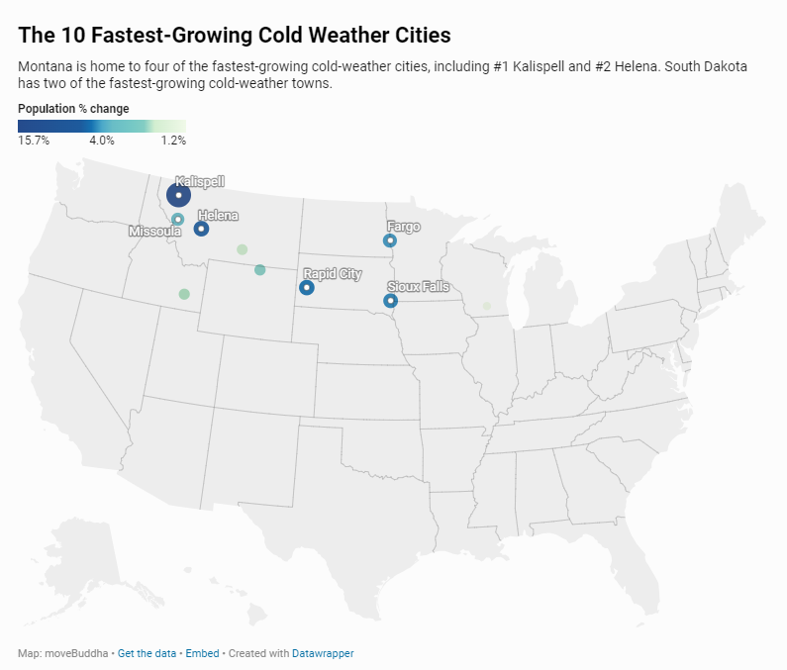
Speaking of Population…Fun Fact
Notes:
#1 Kalispell, Montana, is America’s fastest-growing cold-weather city. Kalispell’s population grew nearly 16% from 2020 to 2022. The average December temperature is 24.1°F.

Slide 5
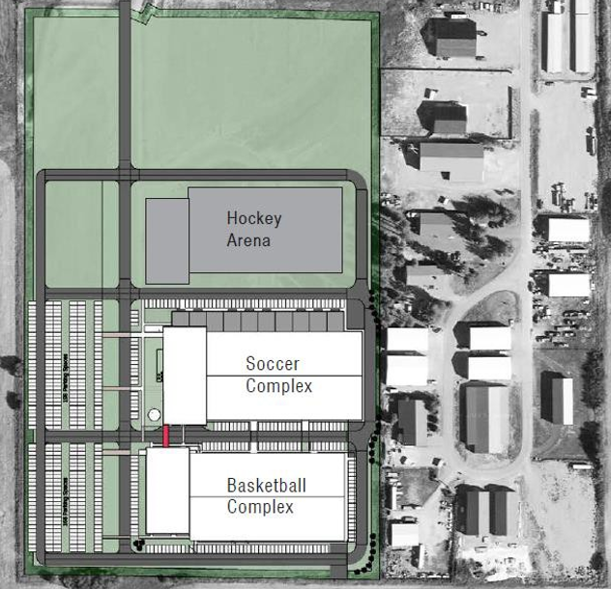

2023 Kalispell Business & Community Highlights
Parkline Towers going up, up, up! The old Ford Dealership site above the entrance to Evergreen and on the Park Line Trail. 224 Units with planned completion in 2024. Adding much needed variable inventory to Kalispell.
Flathead Valley Community College received a $4 million donation for an Entrepreneurship center.
Notes:
Discover Kalispell MT completed a feasibility study on an indoor professional sport facility with a lens on Sports Tourism in spring of 2023. As a result, across from GPIA a new private venture facility breaks ground in March on 25 acres, 3 buildings – basketball, ice hockey arena (2 sheets), and soccer complex with retail frontage on all three buildings.
Mic Ruis’ development at the Silos on West Center opened the first 40 available units on Feb. 1. – last week.
The Parkline Towers has gone up quickly and is expected to be completed __________, 2024 and will have 224 units. 1, 2 and 3 bedrooms apartment homes.

Slide 6
2023 Kalispell Business & Community Highlights
Pioneer Baseball’s newest team, Glacier Range Riders - The Kelly family hosted Opening Day June 14, 2022. Facilities and Club House continued expansion and were completed in 2023.
With the rise in interest rates and slower immigration, we have seen the market cooling in Kalispell and the Flathead. Realtors and mortgage lenders continued to see sales, but more days on market, lower selling prices, and higher levels of inventory.
Glacier Park International Airport experienced a 1% increase in enplanements over 2021 and the highest number ever. Due to lack of crews and high jet fuel prices, we lost two airlines in 2022. The terminal expansion broke ground and Phase 1 is to be completed in 2023. The cost for phase 2 has increased substantially so grants are being written and there may be adjustments to phase 2 to deal with these increases.
Notes:
The Range Riders had a second great season. The completed facilities include fantastic and much needed event and meeting space.
Real Estate in the Valley has changed both in the single family home market as well as multi-family. We’ve seen price adjustments, longer times on market and rental rates coming down.

Slide 7
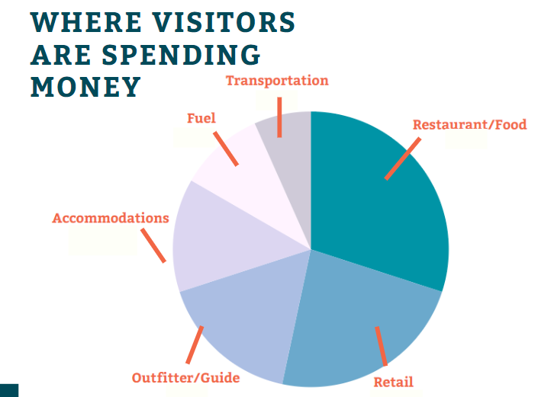
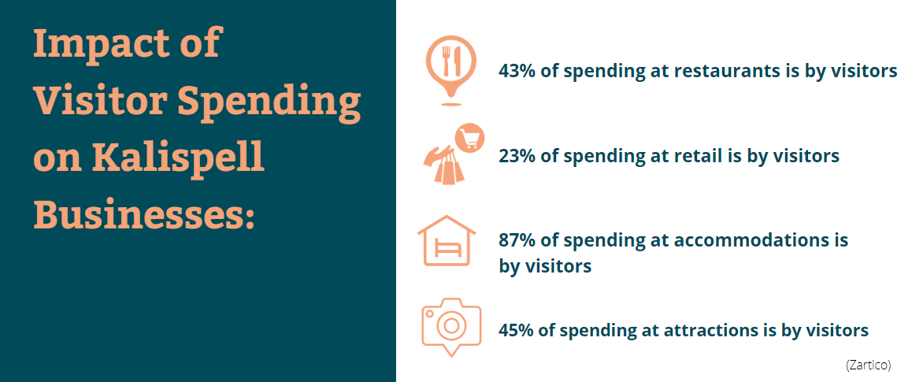
Kalispell Economy
Technology & Innovation Manufacturing
Healthcare
Tourism
  Economic Impact:
Notes:
Technology and Innovation manufacturing remain strong in the Flathead and Kalispell. From Mountain Meadow Herbs to Applied Materials, things remain healthy, and workforce availability has improved.
Healthcare has been a huge part of our economy for many years and as you, I’m sure are all aware, we will see changes in 2024 as the merger of Logan Health and Billings Clinic is completed. We are not sure of all of the ramifications at this point – but stay tuned.
Just as with our housing, we have seen tourism and its economic impact cooling off slightly. And as we hit 2024, our occupancy in both November and December was down and the Discover Kalispell Chamber keeps their focus on our shoulder seasons. We are disappointed to report, but completely beyond our control and decision making, The Spartan race and Highlander will not be a part of our 2024 so we are deliberately, and with a laser focus working on finding new niches to fill our hotels.

Slide 8
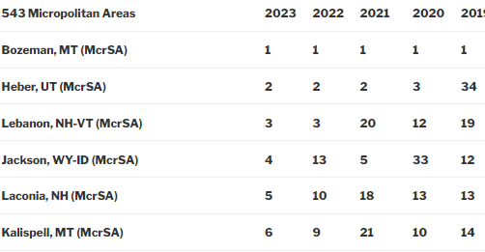
POLICOM RATINGS…NO. 6…up from 9!
543 Micropolitan Areas
“Economic strength is the long-term tendency for an area to consistently grow in both size and quality.”
Notes:
The definition of a micropolitan statistical area:
A Micropolitan area must have an urbanized area of at least 10,000 population but less than 50,000 population. It must be at least one county.
In 2023 – Kalispell ranks number 6 in the nation out of 543, we ended 2022 in 9th place – we are still growing in the right direction.

Slide 9
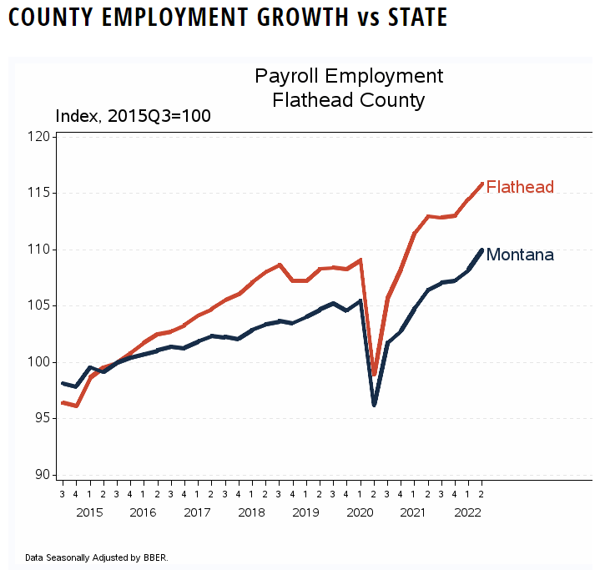
Employment
Flathead Valley 2022
Unemployment – 3.0%
Labor Force – 51,041
Employed – 49,534
Total Population – 108,386
Flathead Valley 2023
Unemployment – 3.0%
Labor Force – 51,041
Employed – 49,534
Total Population – 108,386

Slide 10
Cost of Living Comparison
compared to national average 2023
Kalispell Overall 97.87%
Housing -25.6%
Helena Overall 103.46%
Housing -26.8%
Missoula Overall 101.96%
Housing -26.8%
Bozeman Overall 101.96%
Housing -26.8%
The calculations are based on the total cost of energy, food, healthcare, housing and transportation, among other factors.
Source: salary.com
Notes:
We are still affordable comparably when comparing to the national average using Cost of Living data.

Slide 11
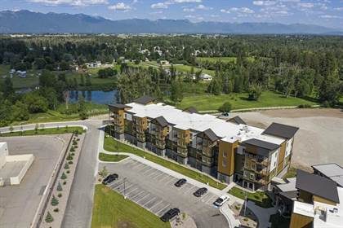
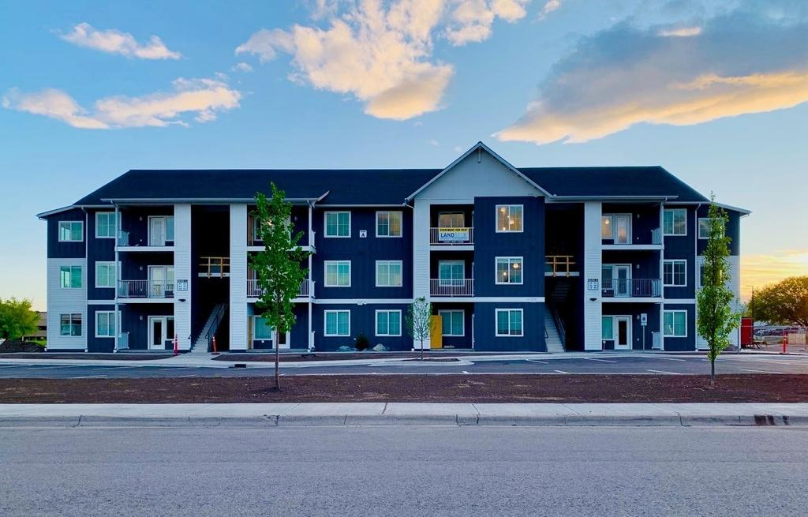
WORKFORCE,
WORKFORCE,
WORKFORCE
HOUSING,
HOUSING,
HOUSING
Notes:
Businesses still reports that workforce–housing affordability and child care remain obstacles to job creation and company growth. The Chamber continues to be all in on these issues.

Slide 12
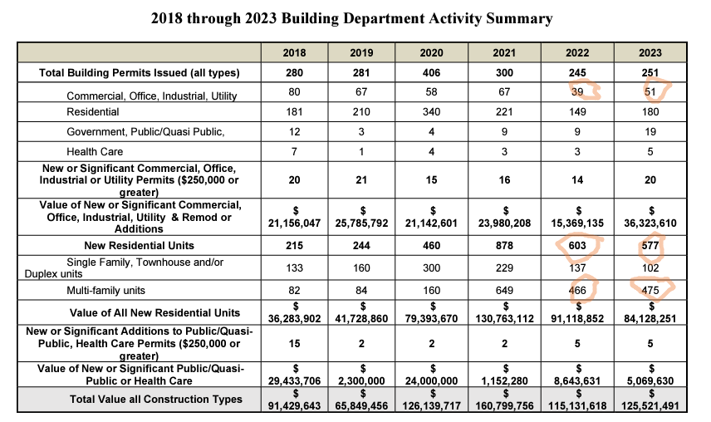
City of Kalispell Permit Activity
Notes:
It is good to see that commercial picked back up a bit with 51 vs. 39 permits
New residential over all continued to decline from it’s peak of 878 in 2021 to 577 – 26 less permits
Multi family is back up just slightly to 475

Slide 13
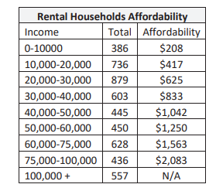
Multifamily Market
The data indicates 60% of the rental population cannot afford the average rent in the Flathead Valley. 9% of the renters meet the affordability index requirement for the average rent and the remaining population exceeds the affordability index requirements.
Studio apartments – average $1,100/month
1 Bedroom/1 Bath – average over $1,450/month
2 Bedroom/2 Bath – average over $1,750/month

Slide 14
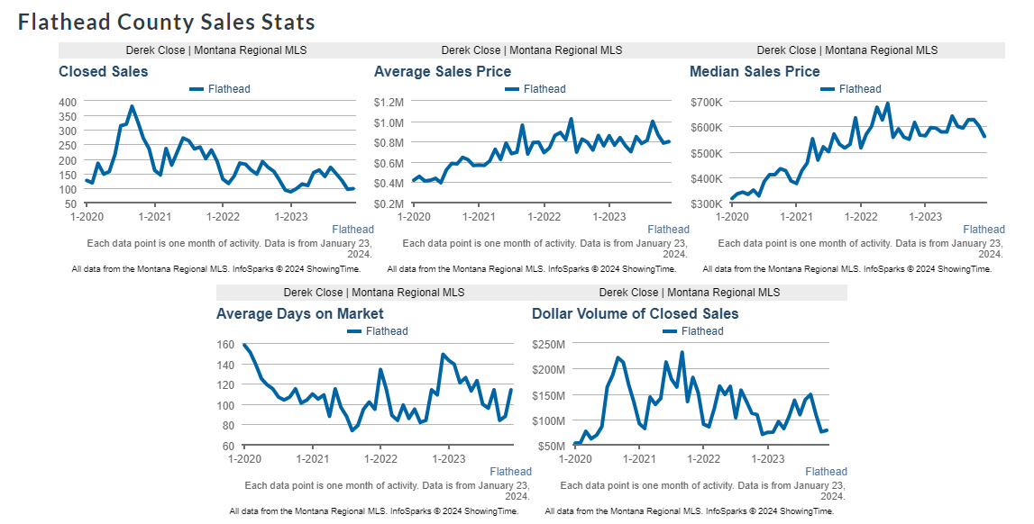
Flathead County Sales Stats
Notes:
Closed Sales – September 2020 was the peak with 381 and December 2023 ended with 98
Average Sales Price – Peak: June 2022 - $1,023,228 vs December 2023 - $799,567
Days on Market in Flathead County – Lowest point in August of 2021 was 74 and December 2023 – 114

Slide 15
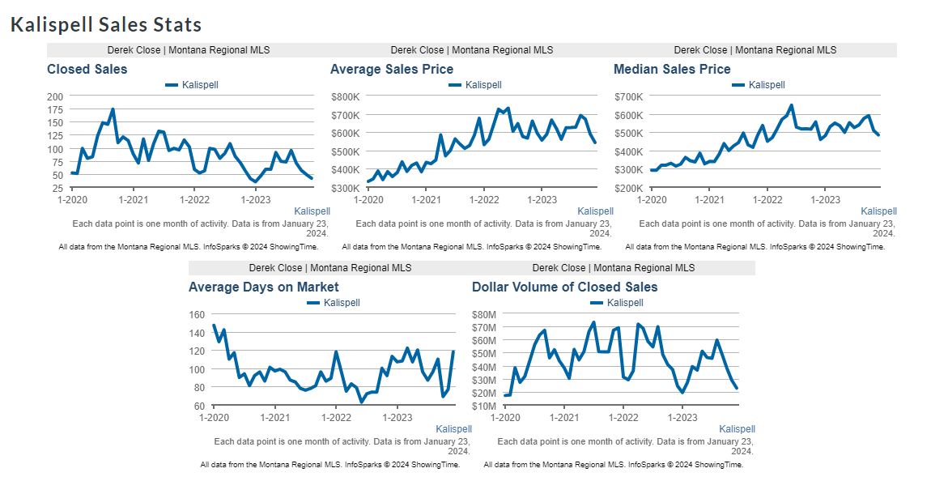
Kalispell Sales Stats
Notes:
Closed Sales – from the High in Sept 2020 of 174 to December 2023 at 42
Average Sales Price – Peak in June of 2022 at $731,420 to December 2023 $543,376….below December 2022 - $595,118 – The cooling we talked about.
Average Days on Market – lowest was June of 2022, December 2023 – 118 days

Slide 16
2024 & beyond… in Kalispell
Workforce is, and will continue to be, an issue.
Housing affordability and supply will continue to be an issue; however, supply chain issues are stabilizing and interest rates may start to fall.
Childcare accessibility, affordability, and quality will continue to be an issue (however, the Kalispell Chamber Action Plan is underway).
Growth impacts continue to emerge and need addressing. Vagrancy and homelessness, public safety issues
Anticipate continued steady business and community growth as we saw in 2023.

